Slide 1
Agenda: Part A
Strategy
gft Cheatsheet
4-5 Functions + 4 Arguments
Amazing how much can be done with so little
Seven Simple Examples
More Tasks: MT, ASR, Vision
Two Questions
How do we find the good stuff?
How do we use the good stuff?
Why de-emphasize pre-training?
Conclusions

Slide 2
Seven Simple Examples
Summary
Summary with patterns (__contains__)
Predict: Sentiment Analysis & Text Classification
More tasks: token_classification, fill-mask
Input from datasets (as opposed to stdin)
gft_predict → gft_eval
gft_fit (aka fine-tuning)

Slide 3
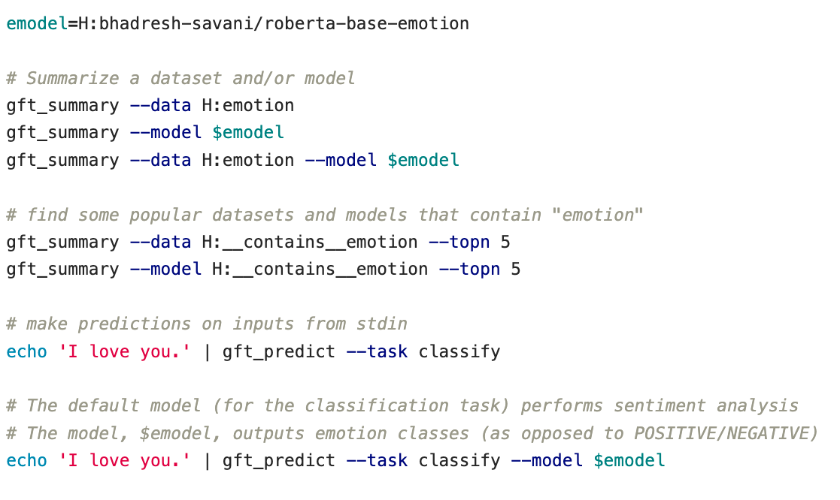
Seven Simple Examples: 1 of 7 Summarize (almost) anything
Emotion Classes
Summarize both data and model

Slide 4
Seven Simple Examples: 2 of 7 Summary with patterns (__contains__)
Search Engine
(Embarrassment of Riches)
Find datasets on HuggingFace that contain “emotion”
Find models on HuggingFace that contain “emotion”

Slide 5
Seven Simple Examples: 3 of 7 Predict: Sentiment Analysis & Text Classification
Default model → Sentiment Analysis
Emotion Classes

Slide 6
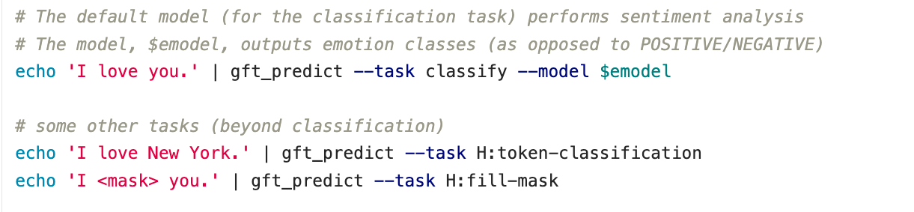
Seven Simple Examples: 4 of 7 More tasks: token_classification, fill-mask
NER: Named Entity Recognition
Cloze (1953)
https://en.wikipedia.org/wiki/Cloze_test

Slide 7
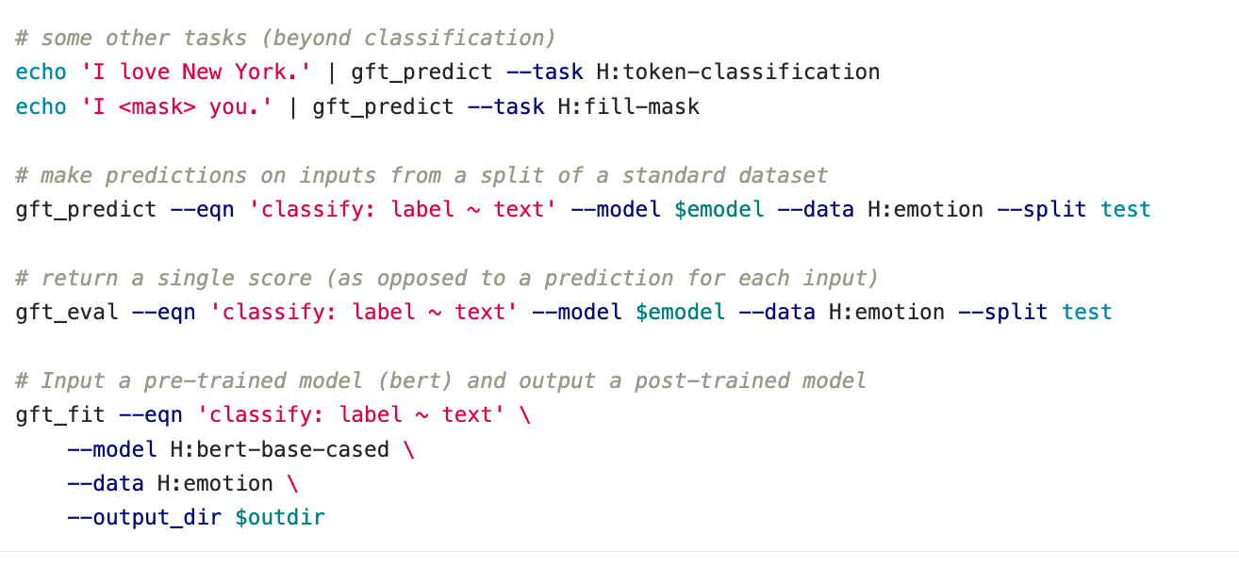
Seven Simple Examples: 5 of 7 Input from datasets (as opposed to stdin)
Specify split
Equation specifies task & columns
Read Input from dataset
(as opposed to stdin)

Slide 8
Seven Simple Examples: 6 of 7 gft_predict → gft_eval
Eval returns a single score for the dataset split
(as opposed to a prediction for each example in dataset split)

Slide 9

A Few Simple Examples: 7 of 7 gft_fit (aka fine-tuning)
Fit returns a post-trained model: $f_{post}$

Slide 10
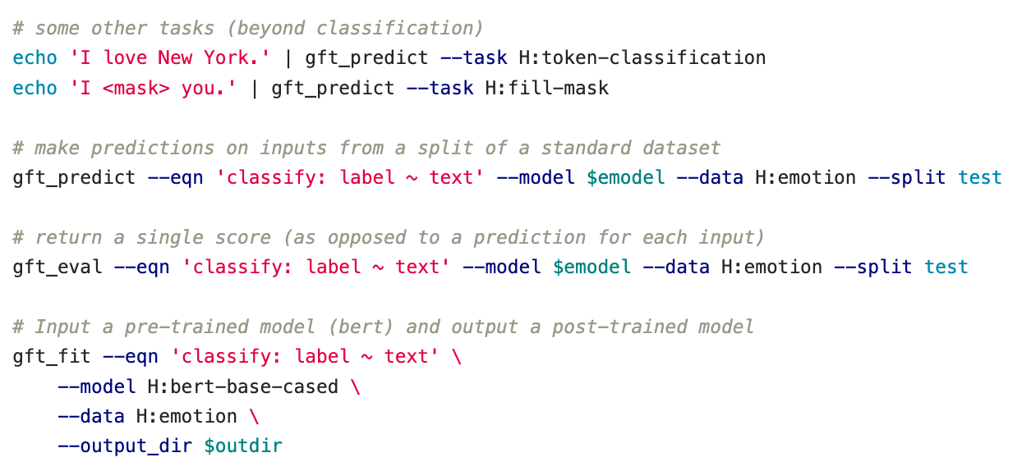
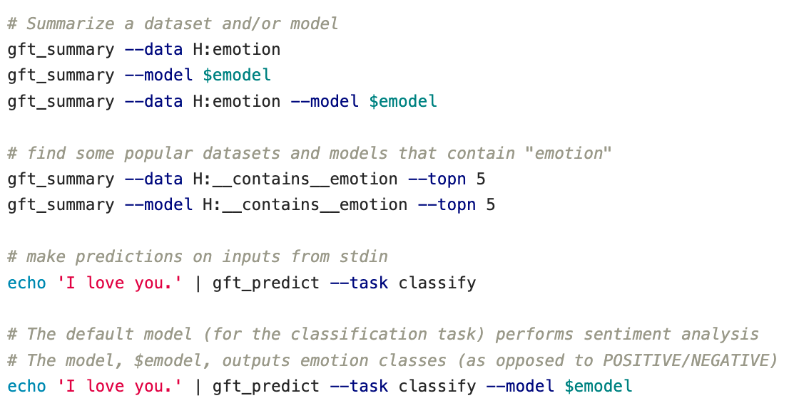
Recap of Seven Simple Examples
4
5
6
1
7
Summary
Summary with patterns (__contains__)
Sentiment Analysis & Text Classification
More tasks: token_classification, fill-mask
Input from datasets (as opposed to stdin)
gft_predict → gft_eval
gft_fit (aka fine-tuning)
2
3
3

Slide 11
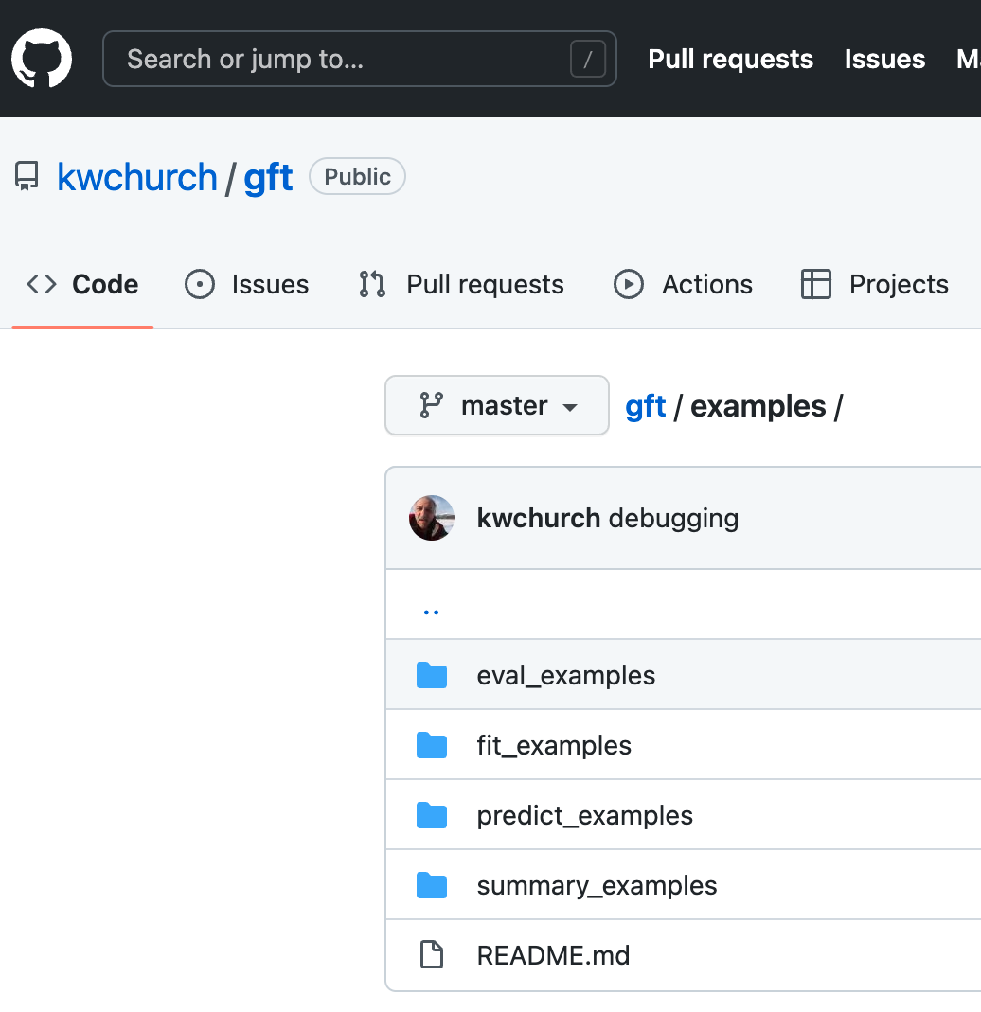
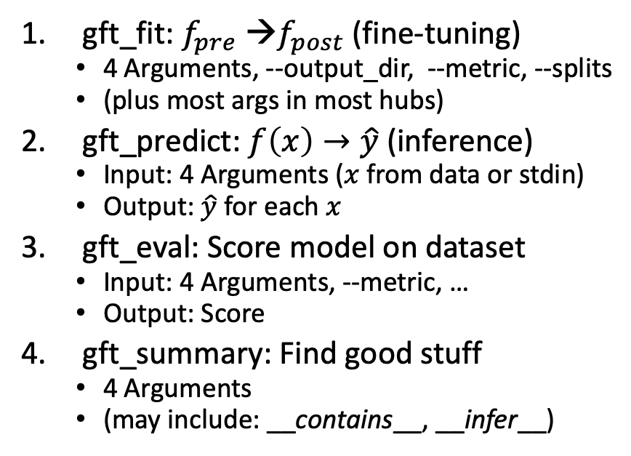
Hundreds of Examples: https://github.com/kwchurch/gft
Subdirectories under $gft/examples
4 Functions
fit_examples
predict_examples
eval_examples
summary_examples
Look for *.sh files under these directories
find $gft/examples –name ”*.sh”
4 arguments:
--data, --model, --eqn, --task
gft_fit: $f_{pre}$ →$f_{post}$(fine-tuning)
4 Arguments, --output_dir, --metric, --splits
(plus most args in most hubs)
gft_predict: $f\left(x\right)→\hat{y}$ (inference)
Input: 4 Arguments ($x$ from data or stdin)
Output: $\hat{y}$ for each $x$
gft_eval: Score model on dataset
Input: 4 Arguments, --metric, …
Output: Score
gft_summary: Find good stuff
4 Arguments
(may include: __contains__, __infer__)

Slide 12
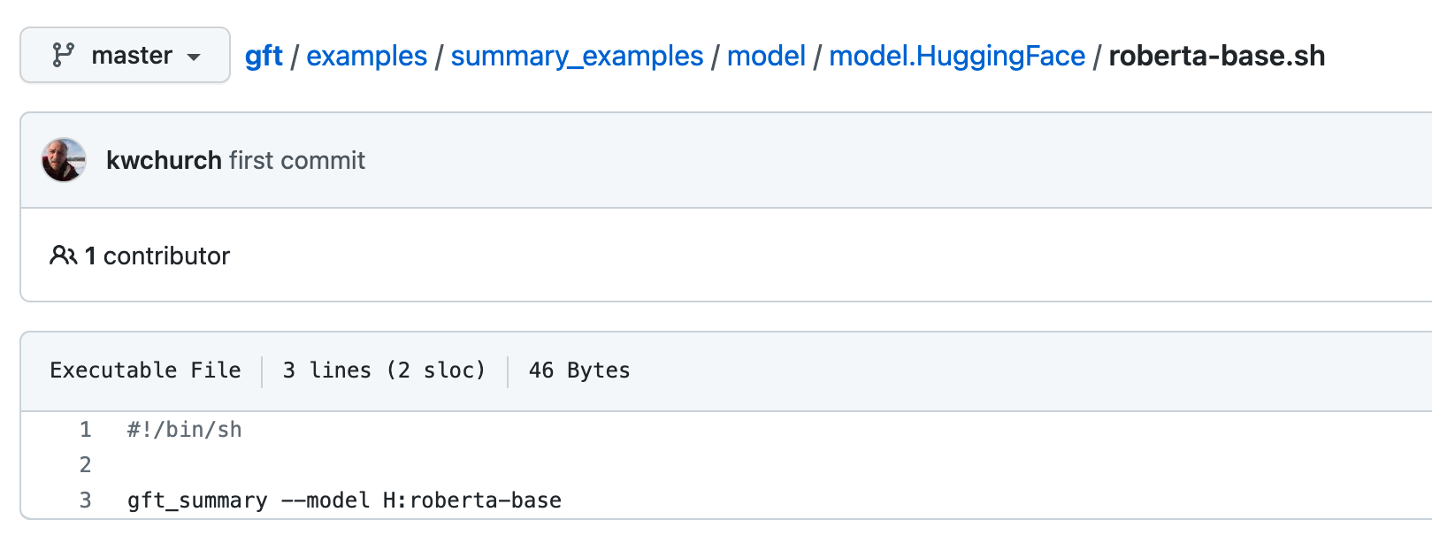
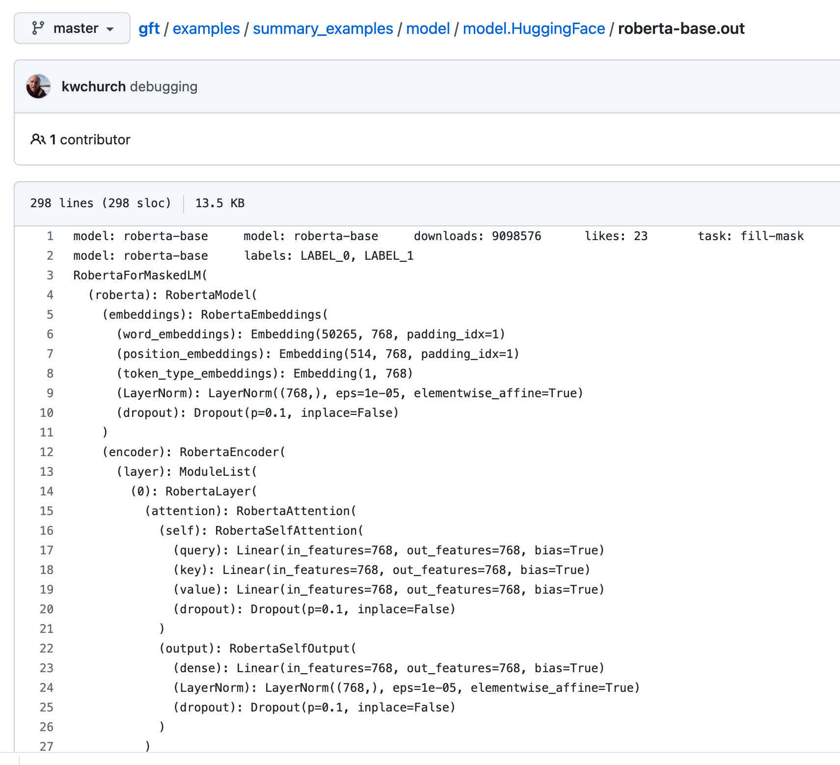
Hundreds of Examples: Regression Testing
Regression testing looks for errors in output
Input
Output
Pass: No Errors

Slide 13
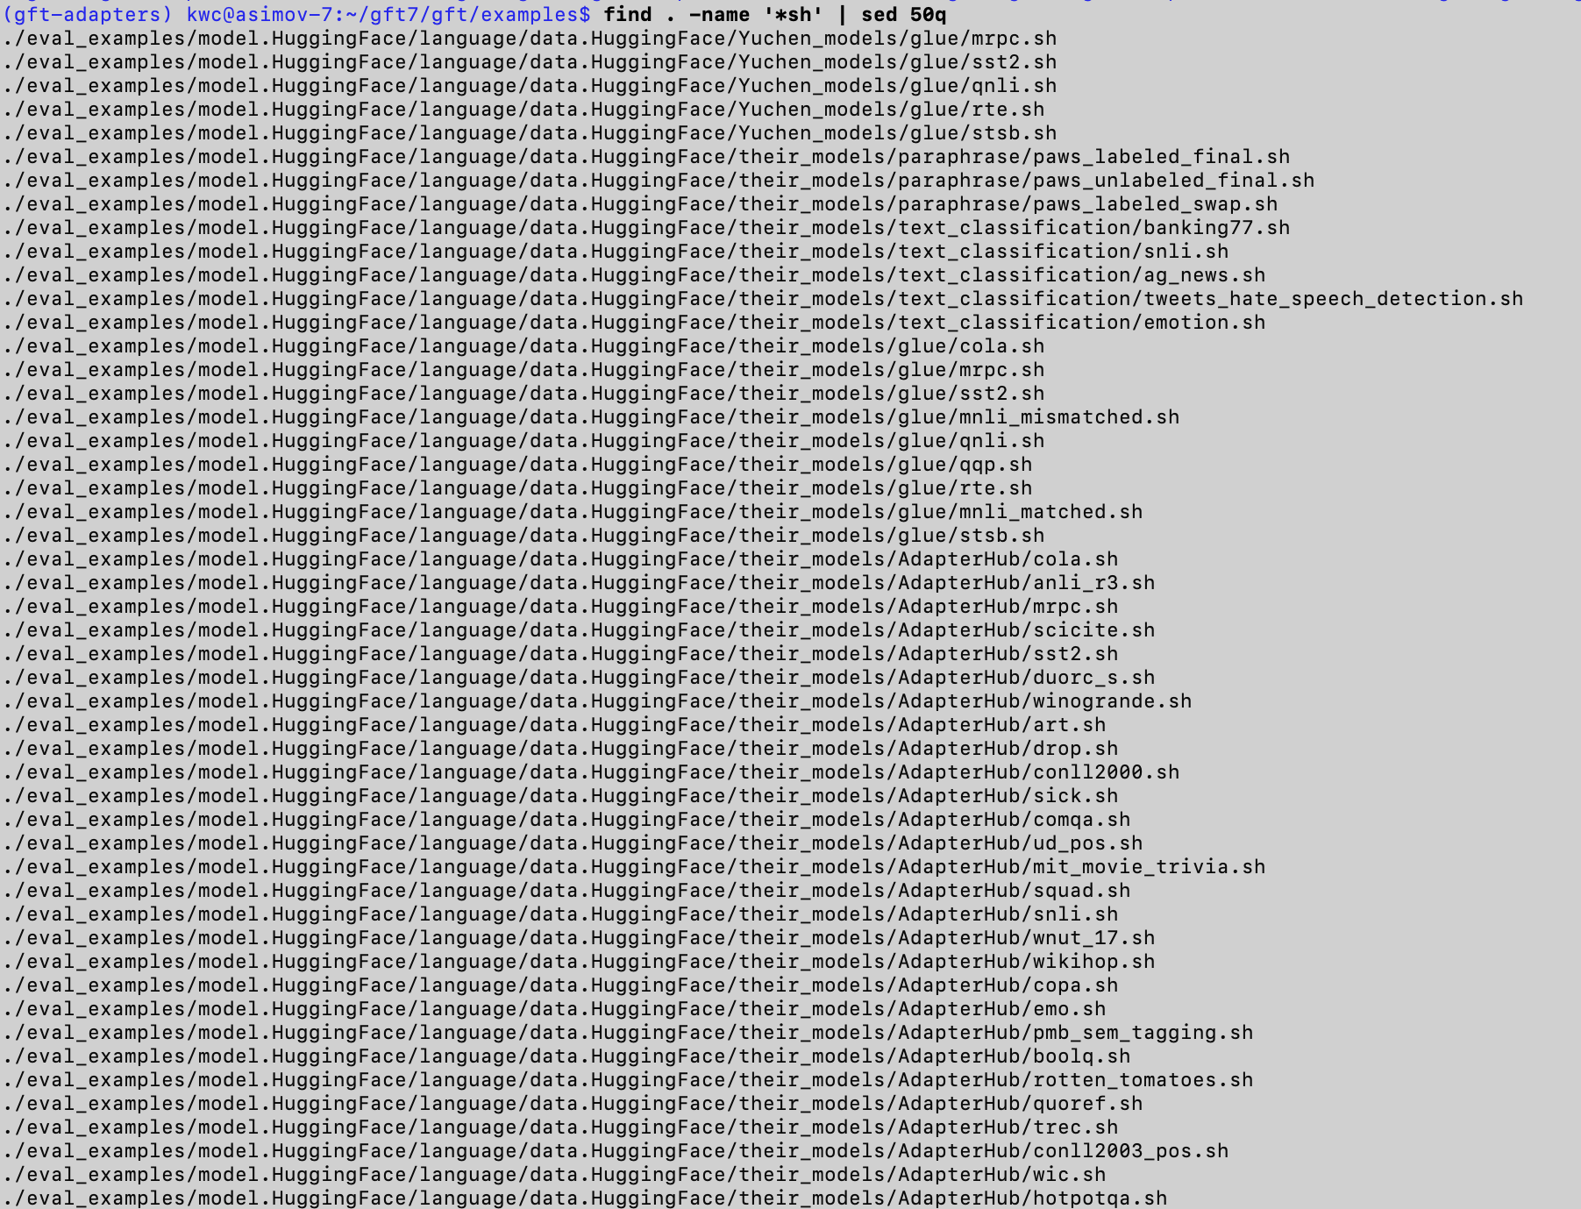
Guide to Hundreds of Examples
Subdirectories under $gft/examples
Naming Conventions
fit_examples (1 arg)
--output_dir $1
predict_examples (0 args)
eval_examples (0 args)
summary_examples (0 args)
Look for *.sh files under these directories
find $gft/examples –name ”*.sh”
4 arguments:
--data, --model, --eqn, --task
Function
fit, predict, eval, summary
Models
model.HuggingFace/model.Paddle
our_models/their_models
Data
data.HuggingFace/data.Paddle
Benchmarks/Tasks
GLUE, SQuAD, sentiment,…
Hyper-parameter Tuning

Slide 14
Cola subset of Glue, with pretrained models and data from HuggingFace $gft/examples/eval_examples/model.HuggingFace/language/data.HuggingFace/their_models/glue/cola.sh
Input
Output (Sorted by score; 4 errors removed)
for model in textattack/distilbert-base-uncased-CoLA textattack/bert-base-uncased-CoLA textattack/distilbert-base-cased-CoLA textattack/roberta-base-CoLA cointegrated/roberta-large-cola-krishna2020 textattack/albert-base-v2-CoLA gchhablani/bert-base-cased-finetuned-cola yoshitomo-matsubara/bert-base-uncased-cola howey/roberta-large-cola textattack/xlnet-base-cased-CoLA isakbos/Q8BERT_COLA_L_512 EhsanAghazadeh/bert-large-uncased-CoLA_A EhsanAghazadeh/bert-large-uncased-CoLA_B 09panesara/distilbert-base-uncased-finetuned-cola yoshitomo-matsubara/bert-large-uncased-cola textattack/xlnet-large-cased-CoLA Alireza1044/albert-base-v2-cola pmthangk09/bert-base-uncased-glue-cola kamivao/autonlp-cola_gram-208681 mrm8488/deberta-v3-small-finetuned-cola 123abhiALFLKFO/distilbert-base-uncased-finetuned-cola Ahren09/distilbert-base-uncased-finetuned-cola
do
gft_eval --data H:glue,cola --split val \
--eqn 'classify: label ~ sentence’ --model H:$model \
--metric H:glue,cola --figure_of_merit matthews_correlation
done
Model | Score | Seconds
howey/roberta-large-cola | 0.65 | 3.93
textattack/roberta-base-CoLA | 0.64 | 1.6
yoshitomo-matsubara/bert-large-uncased-cola | 0.63 | 5.12
mrm8488/deberta-v3-small-finetuned-cola | 0.63 | 1.62
EhsanAghazadeh/bert-large-uncased-CoLA_A | 0.61 | 4.05
yoshitomo-matsubara/bert-base-uncased-cola | 0.61 | 1.58
EhsanAghazadeh/bert-large-uncased-CoLA_B | 0.60 | 4.13
gchhablani/bert-base-cased-finetuned-cola | 0.60 | 1.57
pmthangk09/bert-base-uncased-glue-cola | 0.58 | 1.53
textattack/albert-base-v2-CoLA | 0.58 | 1.59
textattack/distilbert-base-uncased-CoLA | 0.57 | 1.04
kamivao/autonlp-cola_gram-208681 | 0.56 | 1.52
Alireza1044/albert-base-v2-cola | 0.55 | 1.71
09panesara/distilbert-base-uncased-finetuned-cola | 0.54 | 0.87
textattack/bert-base-uncased-CoLA | 0.53 | 2.35
123abhiALFLKFO/distilbert-base-uncased-finetuned-cola | 0.53 | 0.9
textattack/xlnet-base-cased-CoLA | 0.50 | 2.23
textattack/distilbert-base-cased-CoLA | 0.46 | 0.88
isakbos/Q8BERT_COLA_L_512 | 0.00 | 1.77
textattack/xlnet-large-cased-CoLA | 0.00 | 5.08
cointegrated/roberta-large-cola-krishna2020 | -0.65 | 4.31
Popular models containing “cola”
(not SOTA)

Slide 15
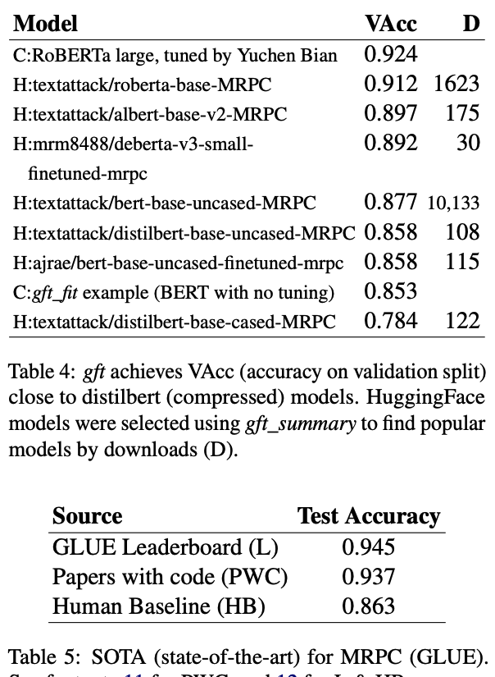
What is ``Good’’ Stuff? Accuracy? Downloads?
Hyper-Parameter Tuning → Small Gains
Best of Hubs
SOTA
Should not compare accuracy across splits
Should not compare accuracy across splits
Best of Hubs are good
(but probably not SOTA)

Slide 16
Agenda: Part A
Strategy
gft Cheatsheet
4-5 Functions + 4 Arguments
Amazing how much can be done with so little
Seven Simple Examples
More Tasks: MT, ASR, Vision
Two Questions
How do we find the good stuff?
How do we use the good stuff?
Why de-emphasize pre-training?
Conclusions

Slide 17
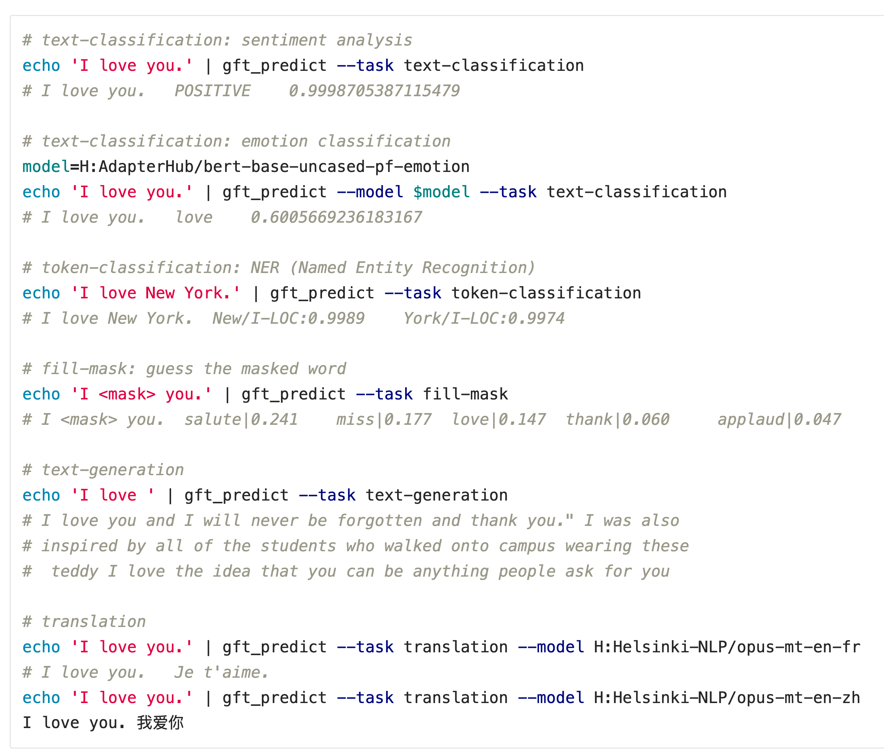
More tasks (1 of 4)
Text Classification
Token Classification
Fill Mask
Text Generation
Machine Translation

Slide 18
More tasks (2 of 4)
Text Classification
Token Classification
Fill Mask
Text Generation
Machine Translation

Slide 19
More tasks (3 of 4)
Text Classification
Token Classification
Fill Mask
Text Generation
Machine Translation
Output is non-deterministic

Slide 20
More tasks (4 of 4)
Text Classification
Token Classification
Fill Mask
Text Generation
Machine Translation

Slide 21
More tasks (4 of 4)
Text Classification
Token Classification
Fill Mask
Text Generation
Machine Translation
English → French
English → Chinese
A Model for: English → French
A Model for: English → Chinese

Slide 22
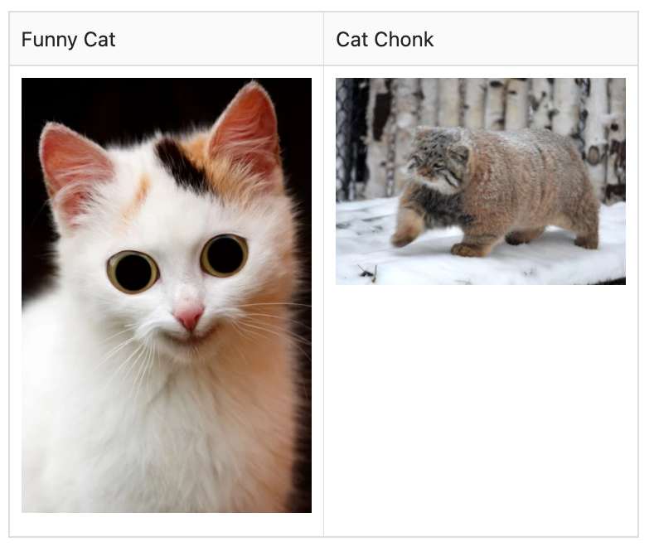
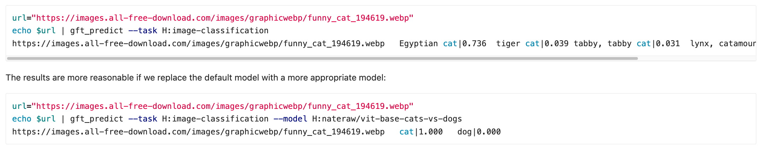
gft_predict –task image-classification
Default Model → 1000 Labels
A Model with Cat/Dog Labels

Slide 23
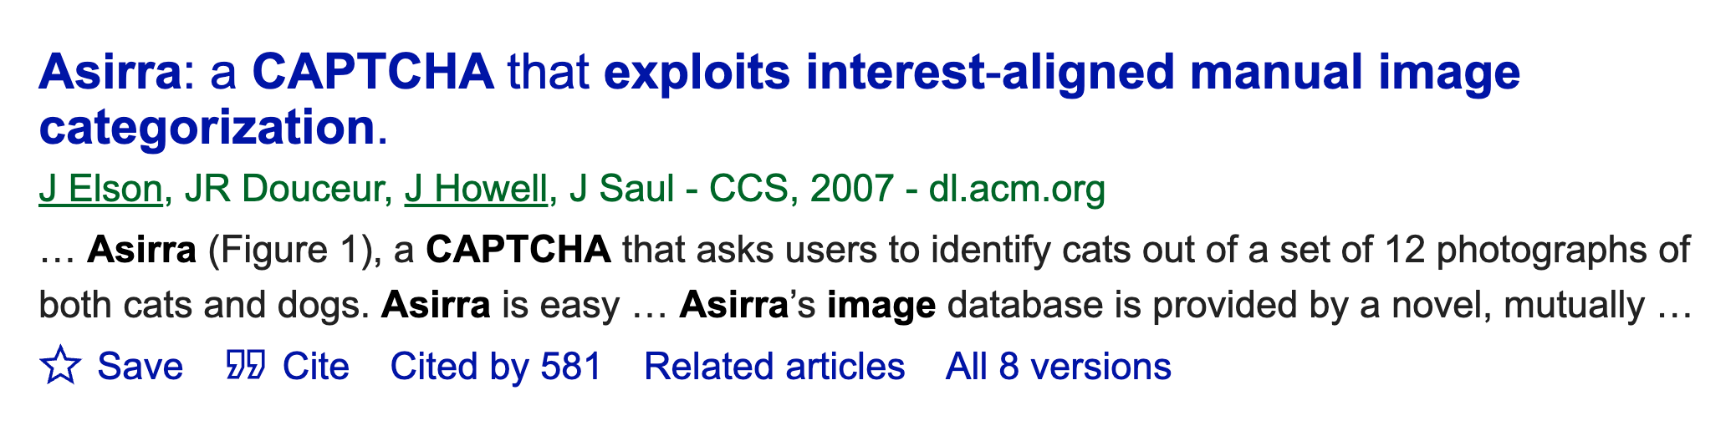
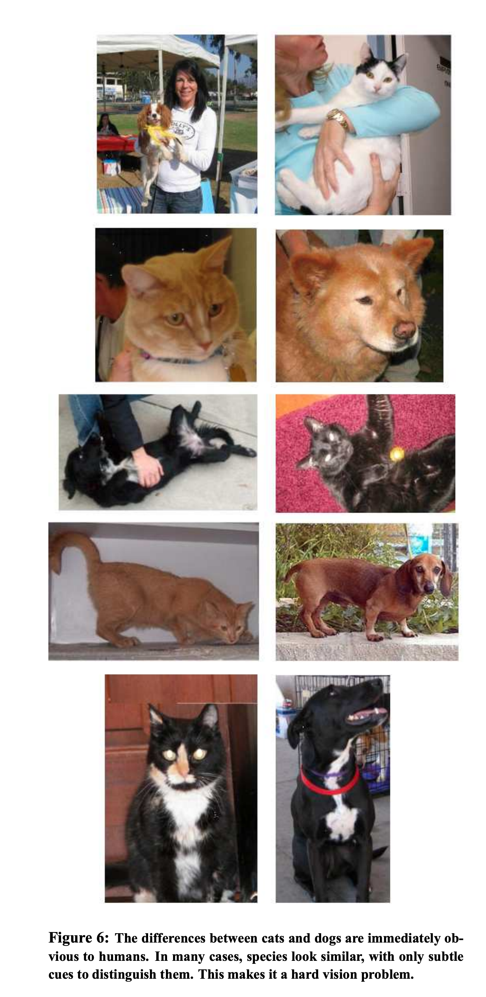
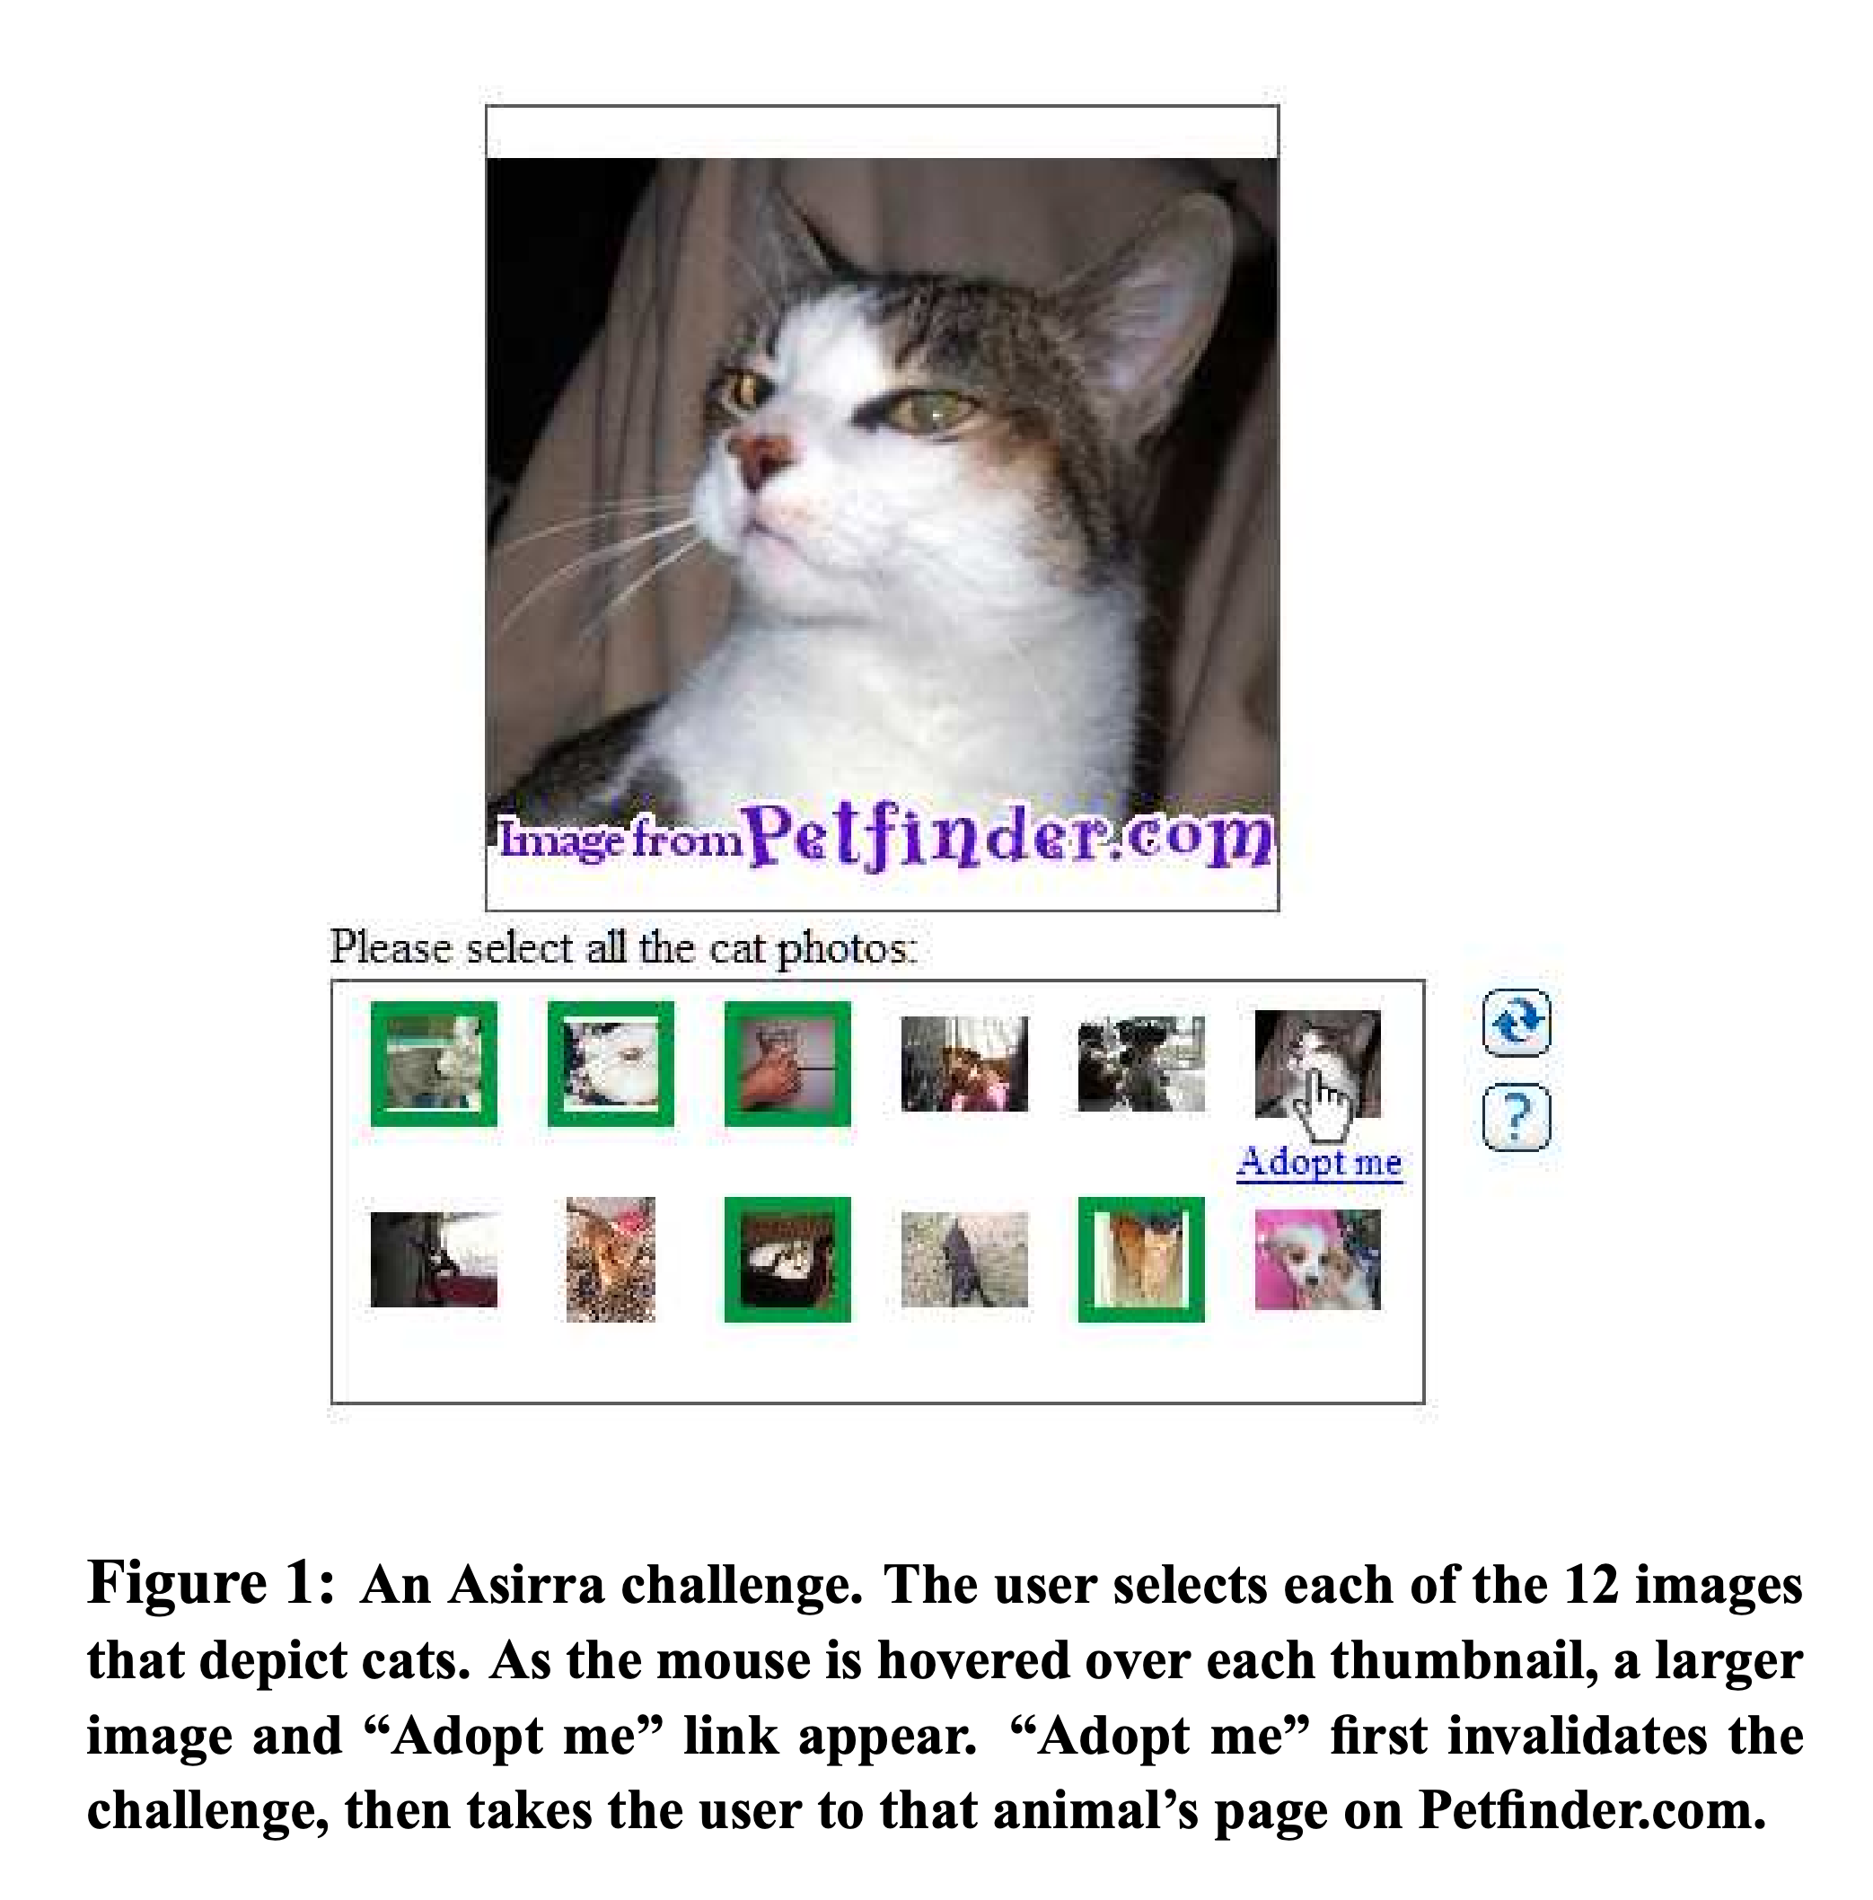
History behind Cat/Dog Task

Slide 24
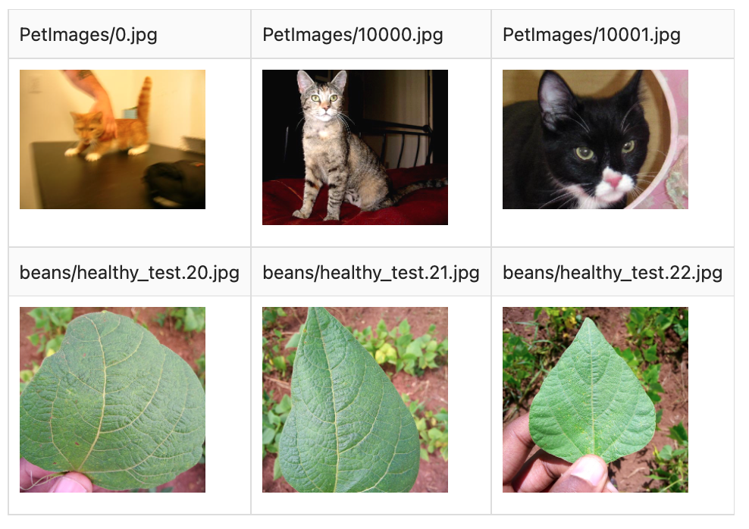
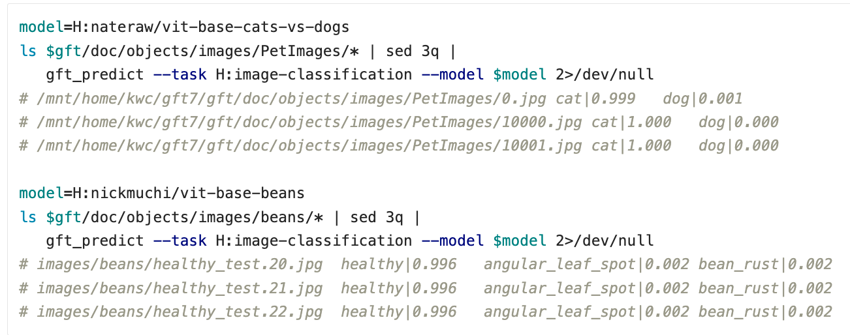
Inputs can also come from files (as well as URLs) There are a few images (and audio files) under $gft/doc/objects

Slide 25
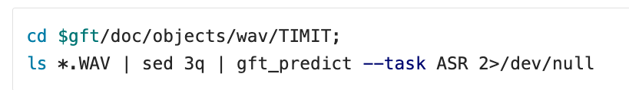
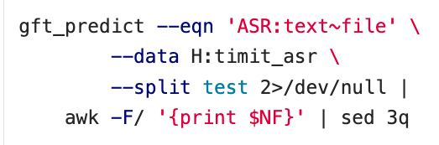
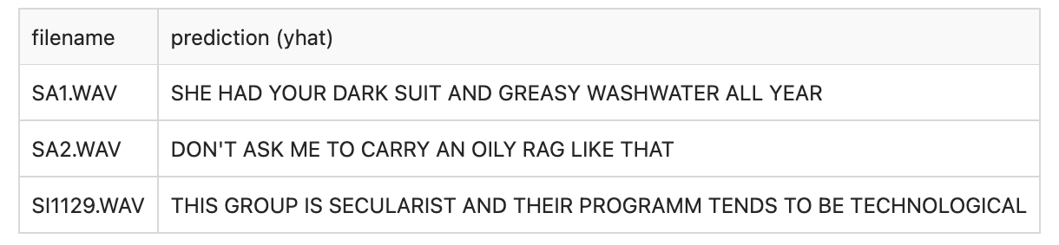
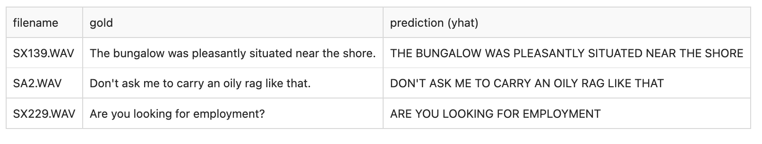
Task: Speech Recognition (ASR, ctc)
Input from stdin
Input from dataset

Slide 26
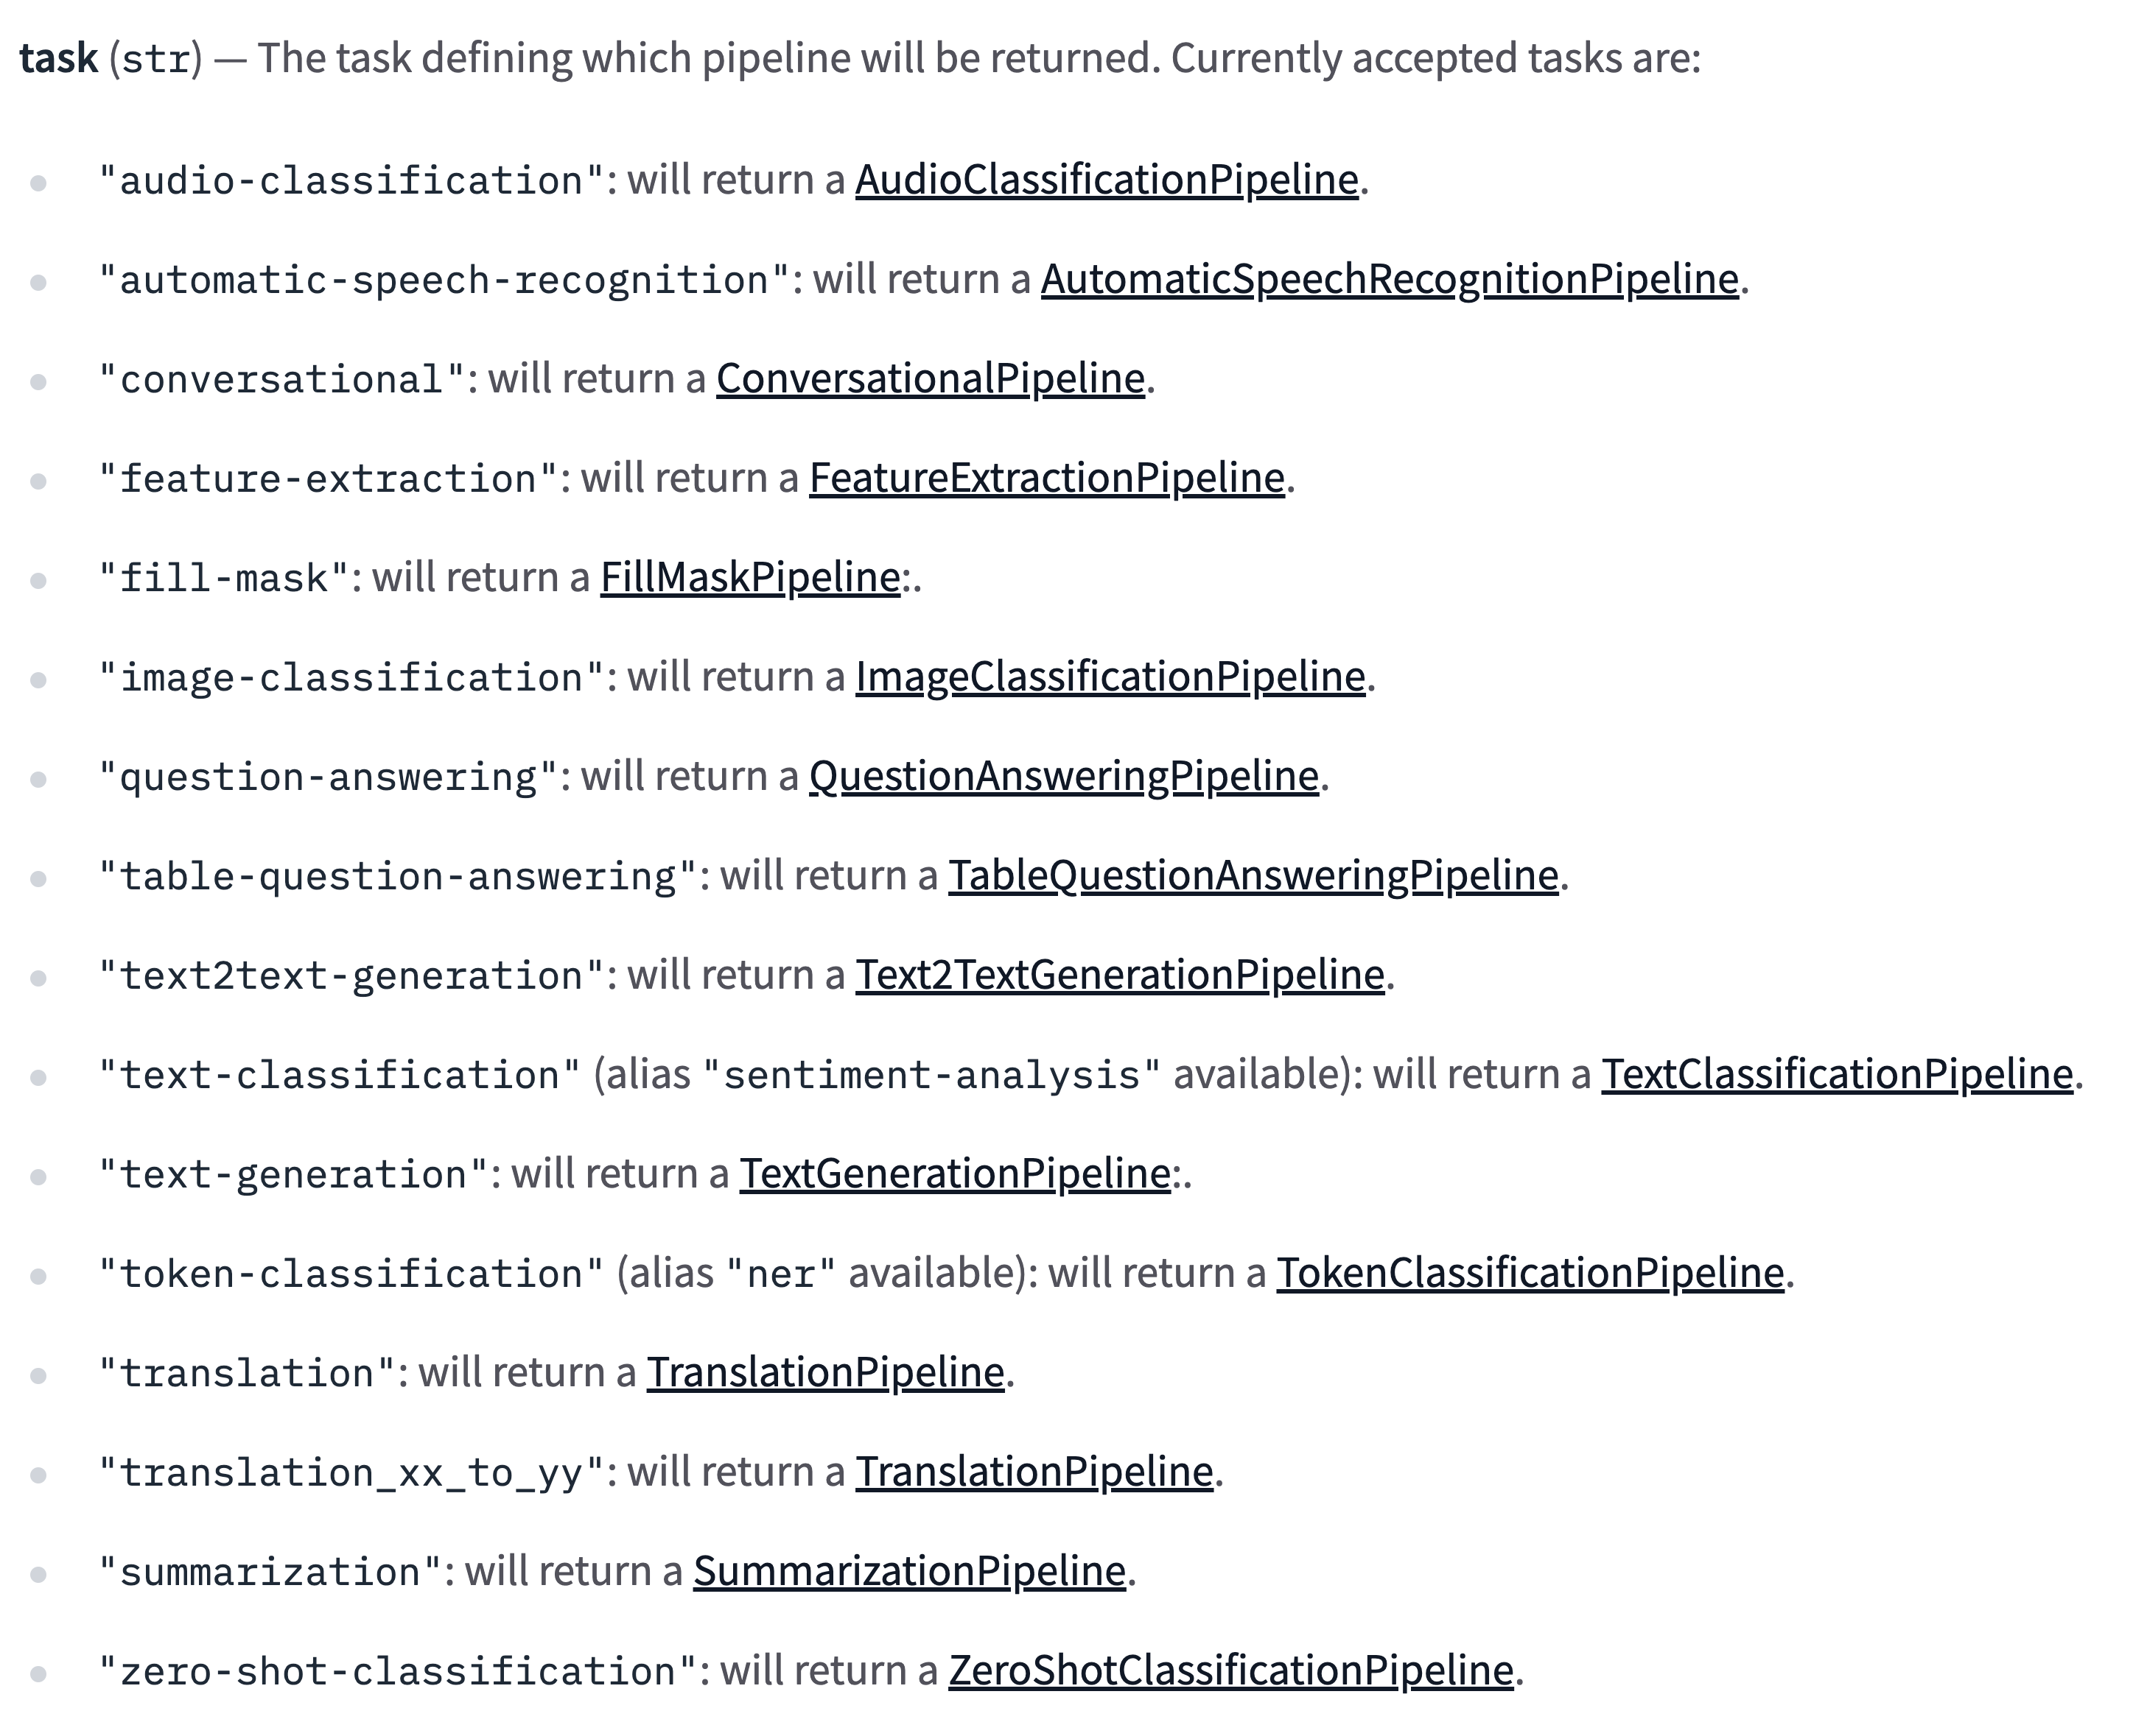
--task argument → HuggingFace Pipelines https://huggingface.co/docs/transformers/v4.16.2/en/main_classes/pipelines

Slide 27
Agenda: Part A
Strategy
gft Cheatsheet
4-5 Functions + 4 Arguments
Amazing how much can be done with so little
Seven Simple Examples
More Tasks: MT, ASR, Vision
Two Questions
How do we find the good stuff?
How do we use the good stuff?
Why de-emphasize pre-training?
Conclusions

Slide 28
Two Questions
How do I find the good stuff?
And how do I use the good stuff?
Presupposition:
Hubs encourage sharing of
Datasets
Models
Tasks

Slide 29
Embarrassment of Riches
Hubs have 40k models & 4k datasets (increasing 3x per year)
Q: How can I find the good stuff?
A: gft_summary

Slide 30
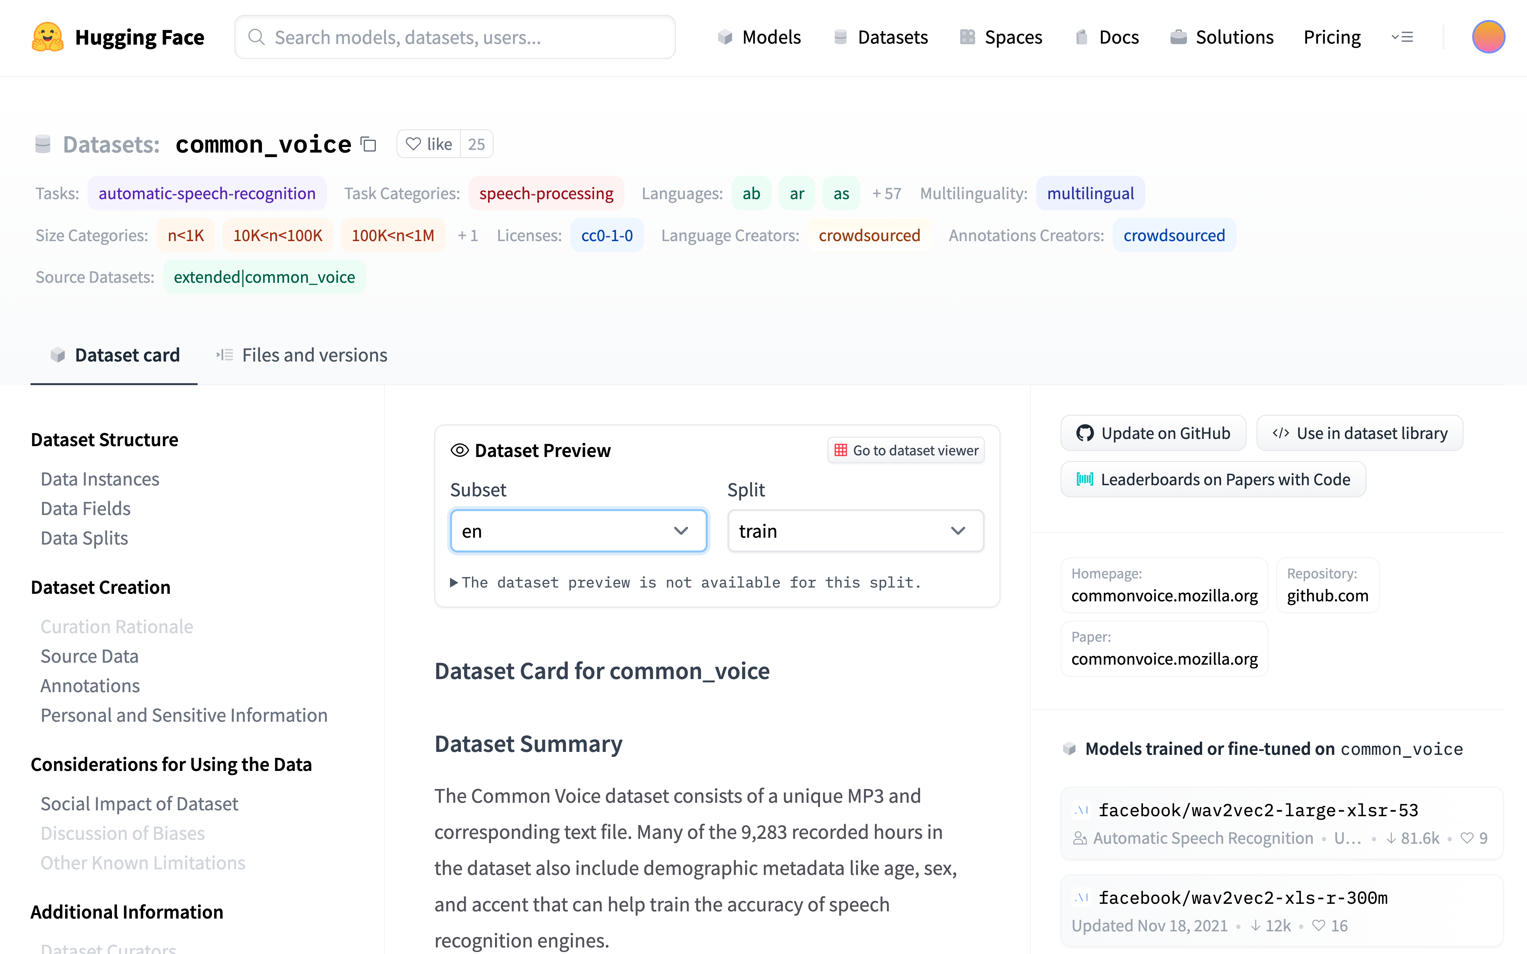
Metrics of Success: How do we find good stuff?
Algo Search: Left Rail
vs
Ad Search: Right Rail
A kind of search engine
Score dataset by:
# of downloads
# of likes
# of models
# of citations

Slide 31
How do I find the good stuff? Popular Datasets? gft_summary –data H:__contains__wiki --topn 20
Dataset | Downloads | Likes | PWC
wikitext | 119,031 | 7 | https://paperswithcode.com/dataset/wikitext-2
wikiann | 20,021 | 6 | https://paperswithcode.com/dataset/wikiann-1
wiki_snippets | 16,550 | 0
wikipedia | 14,729 | 8
wiki_bio | 10,135 | 0 | https://paperswithcode.com/dataset/wikibio
wiki_qa | 9,670 | 1 | https://paperswithcode.com/dataset/wikiqa
wiki_hop | 8,961 | 0 | https://paperswithcode.com/dataset/wikihop
wiki_dpr | 5,310 | 0
wiki_split | 5,260 | 0 | https://paperswithcode.com/dataset/wikisplit
wiki40b | 2,618 | 3 | https://paperswithcode.com/dataset/wiki-40b
wikisql | 2,135 | 2 | https://paperswithcode.com/dataset/wikisql
wikihow | 1,601 | 0 | https://paperswithcode.com/dataset/wikihow
wiki_lingua | 1,508 | 1 | https://paperswithcode.com/dataset/wikilingua
kilt_wikipedia | 1,421 | 2
Tevatron/wikipedia-nq-corpus | 1,368 | 0
wiki_auto | 1,258 | 0
wiki_asp | 1,192 | 1 | https://paperswithcode.com/dataset/wikiasp
wikicorpus | 1,098 | 0
wiki_atomic_edits | 1,058 | 3 | https://paperswithcode.com/dataset/wikiatomicedits
iapp_wiki_qa_squad | 1,033 | 0

Slide 32
How do I find the good stuff? Popular Datasets? gft_summary –data H:__contains__ --topn 20
Dataset | Downloads | Likes | PWC
glue | 926,082 | 26 | https://paperswithcode.com/dataset/glue
super_glue | 306,473 | 9 | https://paperswithcode.com/dataset/superglue
wikitext | 119,031 | 7 | https://paperswithcode.com/dataset/wikitext-2
imdb | 105,321 | 8 | https://paperswithcode.com/dataset/imdb-movie-reviews
squad | 99,954 | 22 | https://paperswithcode.com/dataset/squad
squad_es | 72,163 | 0 | https://paperswithcode.com/dataset/squad-es
paws | 65,433 | 1 | https://paperswithcode.com/dataset/paws
librispeech_asr | 65,325 | 12 | https://paperswithcode.com/dataset/librispeech-1
wmt16 | 48,479 | 2 | https://paperswithcode.com/dataset/wmt-2016
xnli | 41,987 | 5 | https://paperswithcode.com/dataset/xnli
snli | 34,045 | 5 | https://paperswithcode.com/dataset/snli
ag_news | 30,456 | 11 | https://paperswithcode.com/dataset/ag-news
anli | 30,245 | 3 | https://paperswithcode.com/dataset/anli
amazon_polarity | 28,584 | 6
squad_v2 | 28,000 | 3 | https://paperswithcode.com/dataset/squad
conll2003 | 26,012 | 11 | https://paperswithcode.com/dataset/conll-2003
red_caps | 25,940 | 2 | https://paperswithcode.com/dataset/redcaps
common_voice | 25,033 | 26 | https://paperswithcode.com/dataset/common-voice
stsb_multi_mt | 23,866 | 4
trec | 23,313 | 3 | https://paperswithcode.com/dataset/trecqa

Slide 33
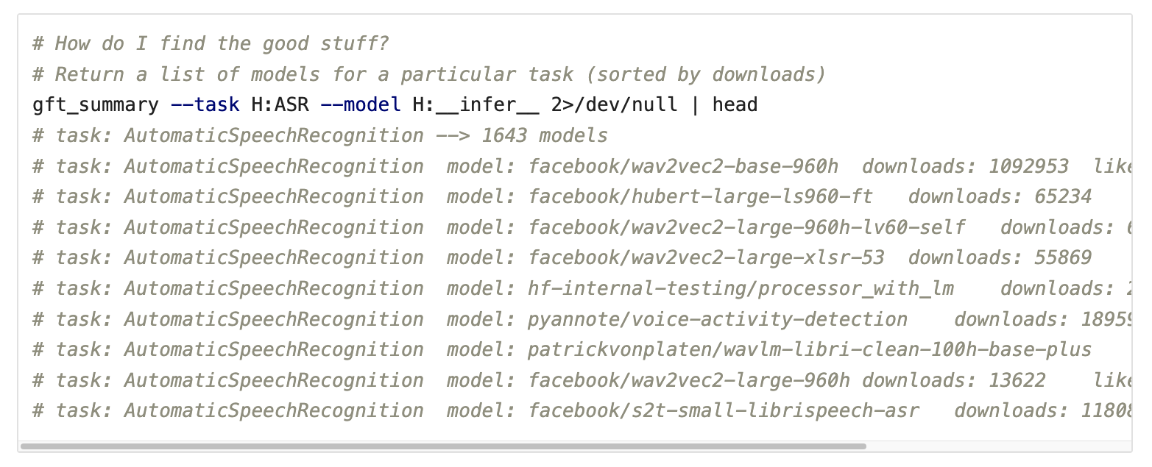
gft_summary: How do I find the good stuff? Find models associated with a task (ASR)
task → list of models (by downloads)

Slide 34
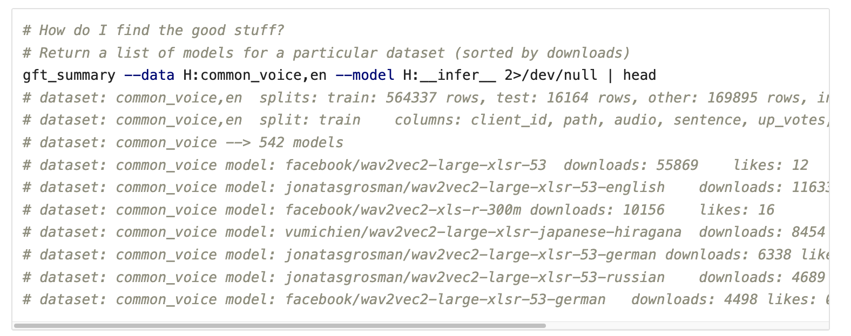
gft_summary: How do I find the good stuff? Find models associated with a task (ASR)
task → list of models (by downloads)
dataset → list of models (by downloads)

Slide 35
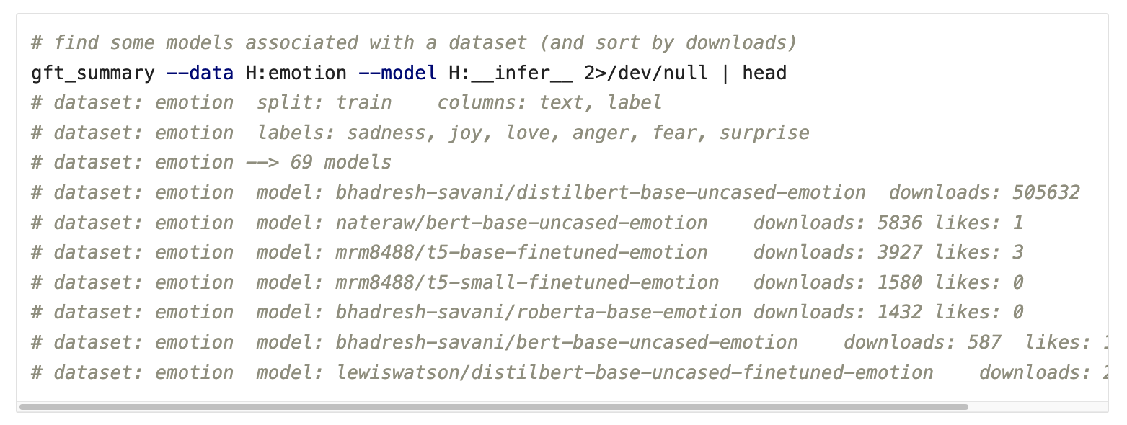
gft_summary: How do I find the good stuff? Find popular models associated with a dataset

Slide 36
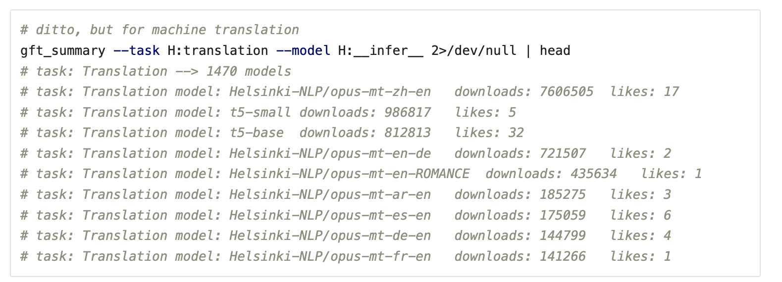
gft_summary: How do I find the good stuff? Find popular models associated with a task (MT)

Slide 37
Embarrassment of Riches
Hubs have 30k models & 3k datasets (increasing 3x per year)
Q: How can I find the good stuff?
A: gft_summary
__contains__
Find popular models/datasets that contain substring
__infer__
Find popular models that are associated with task/dataset
Examples:
gft_summary --data H:__contains__emotion --topn 5
gft_summary --model H:__contains__emotion --topn 5
gft_summary --task H:classify --model H:__infer__ --topn 5
gft_summary --data H:emotion --model H:__infer__ --topn 5

Slide 38
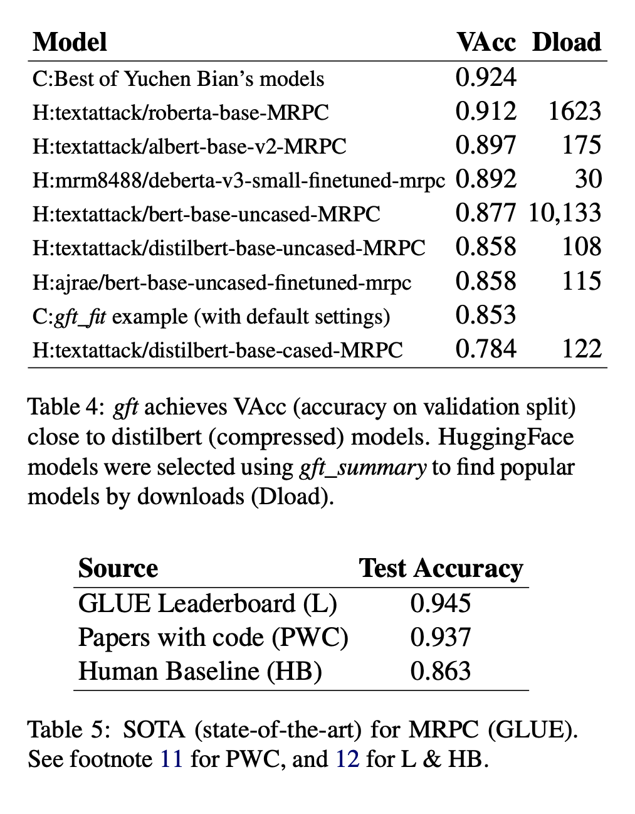
What counts as ``good’’ stuff?
Large Model
(RoBERTa Large)
Many Downloads, but not SOTA
Academic Metrics:
Peer Review (Citations)
Social Media Metrics:
Popular (Downloads)
Tweets / Blogs
SOTA: State of the art
Papers with Code
Leaderboards
Search Engine Optimization (SEO)
Adversarial Game (Arbitrage):
Better Web Search → ``Better’’ SEOs → Better Web Search
Compressed (distilbert)
Compressed (distilbert)
Ease-of-Use

Slide 39

SOTA-Chasing: Leaderboards Considered Harmful SOTA-chasing refers to papers that report SOTA numbers, but contribute little of lasting value to the literature. The point is the pointlessness.

Slide 40

PWC: https://paperswithcode.com/dataset/glue

Slide 41
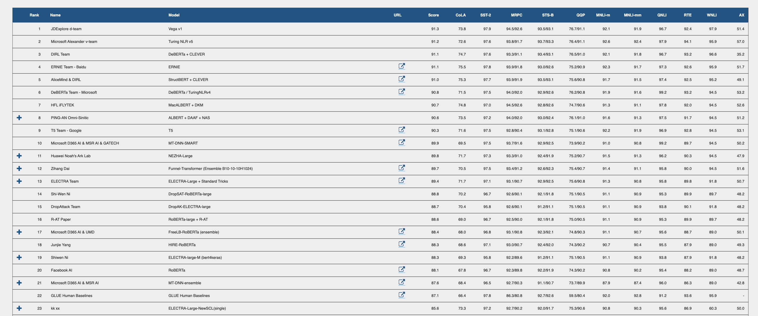

PWC $≠$GLUE Leaderboard

Slide 42
How do I find ``good’’ tasks?
``Good’’ tasks are like ``good’’ stuff
Academic Metrics:
Peer Review (Citations)
Social Media Metrics:
Popular (Downloads)
Tweets / Blogs
SOTA: State of the art
Papers with Code
Leaderboards
Search Engine Optimization (SEO)
Adversarial Game (Arbitrage):
Better Web Search → ``Better’’ SEOs → Better Web Search

Slide 43
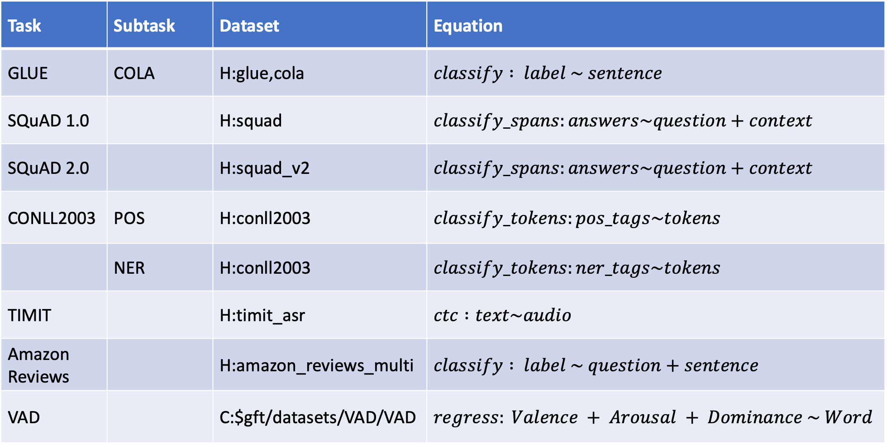

Equation Keywords $≈$ Pipeline Tasks
Task | Subtask | Dataset | Equation
GLUE | COLA | H:glue,cola | $$classify : label \sim sentence$$
SQuAD 1.0 |  | H:squad | $$classify_spans:answers\sim question+context$$
SQuAD 2.0 |  | H:squad_v2 | $$classify_spans:answers\sim question+context$$
CONLL2003 | POS | H:conll2003 | $$classify_tokens:pos_tags\sim tokens$$
 | NER | H:conll2003 | $$classify_tokens:ner_tags\sim tokens$$
TIMIT |  | H:timit_asr | $$ctc :text\sim audio$$
Amazon Reviews |  | H:amazon_reviews_multi | $$classify : label \sim question+sentence$$
VAD |  | C:$gft/datasets/VAD/VAD | $$regress: Valence + Arousal + Dominance \sim Word$$

Slide 44

What are the most popular tasks? 30k Models → Pipeline Tasks (computed from $gft/gft_internals/huggingface_hub/huggingface_datasets.txt)
Models | Pipeline Task
9537 | None
3949 | text-generation
3143 | text-classification (classify)
2390 | fill-mask
2253 | text2text-generation
1508 | automatic-speech-recognition (ctc)
1460 | translation
1340 | token-classification (classify_tokens)
1042 | conversational
983 | question-answering (classify_spans)
982 | feature-extraction
338 | sentence-similarity
320 | summarization
261 | image-classification
Models | Pipeline Task
160 | text-to-speech
68 | zero-shot-classification
55 | audio-to-audio
54 | audio-classification
26 | table-question-answering
12 | object-detection
11 | image-segmentation
9 | text-to-image
4 | structured-data-classification
4 | image-to-text
2 | voice-activity-detection
1 | zero-shot-image-classification
1 | speech-segmentation
1 | protein-folding
1 | pipeline_tag
$f_{pre}$: Pre-trained Model

Slide 45
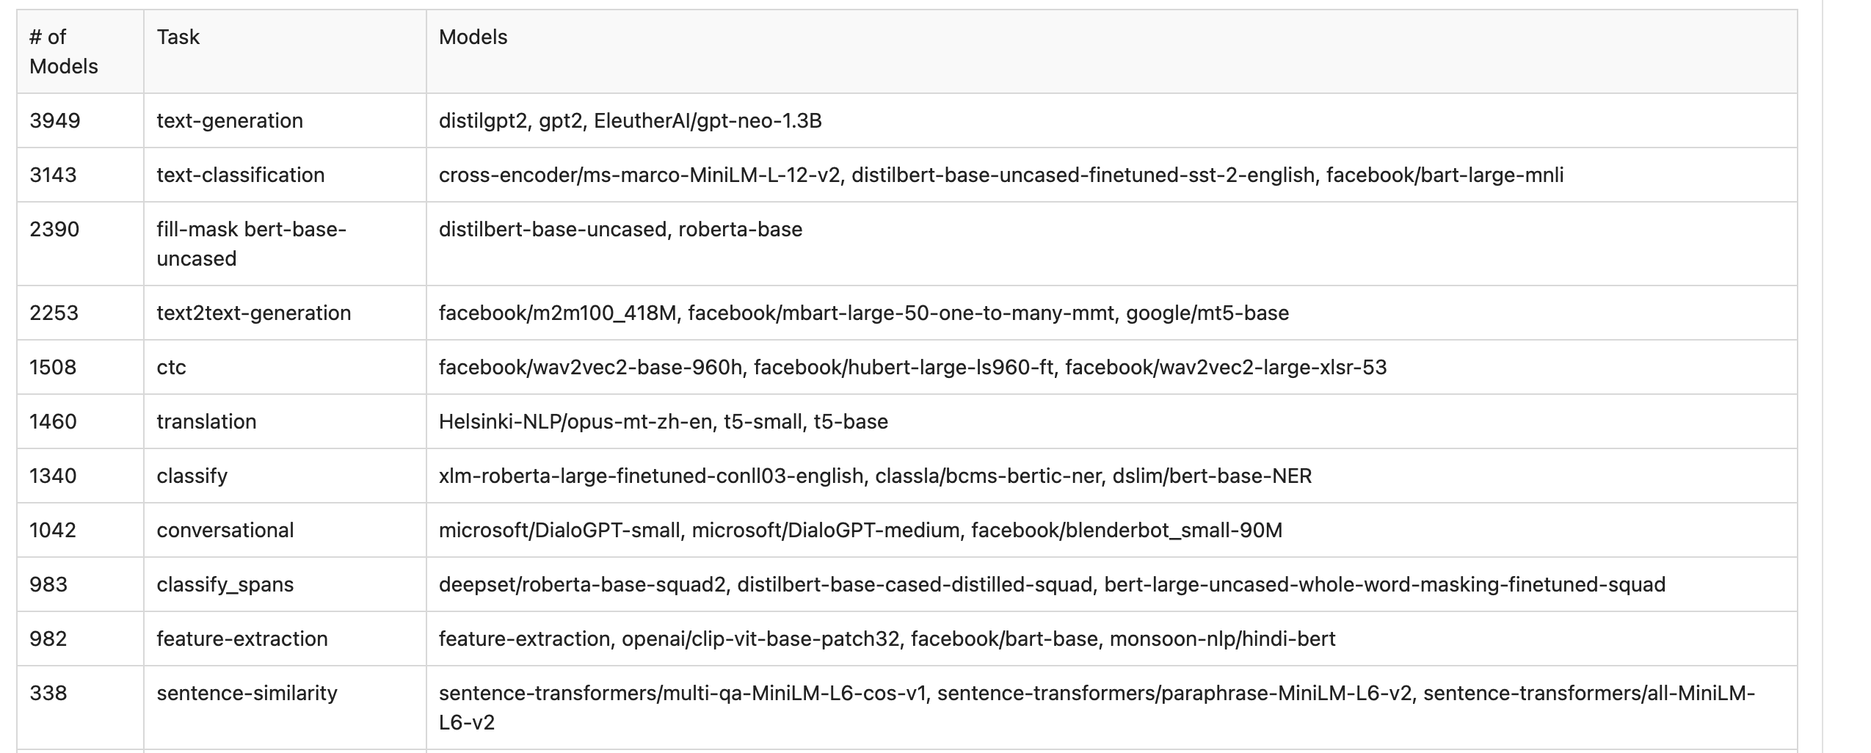
30k Models → Pipeline Tasks (computed from $gft/gft_internals/huggingface_hub/huggingface_datasets.txt)
Models | Pipeline Task
9537 | None
3949 | text-generation
3143 | text-classification (classify)
2390 | fill-mask
2253 | text2text-generation
1508 | automatic-speech-recognition (ctc)
1460 | translation
1340 | token-classification (classify_tokens)
1042 | conversational
983 | question-answering (classify_spans)
982 | feature-extraction
338 | sentence-similarity
320 | summarization
261 | image-classification
Models | Pipeline Task
160 | text-to-speech
68 | zero-shot-classification
55 | audio-to-audio
54 | audio-classification
26 | table-question-answering
12 | object-detection
11 | image-segmentation
9 | text-to-image
4 | structured-data-classification
4 | image-to-text
2 | voice-activity-detection
1 | zero-shot-image-classification
1 | speech-segmentation
1 | protein-folding
1 | pipeline_tag

